Slide 1
IBM University Engagement Project Submission
“Exploring the Power of Agentic AI with IBM Granite and LangFlow”

Slide 2

Project Tile – Nutrition Agent
Domain of Project – Artificial Intelligence (AI) & HealthTech
Student Name | Recent Passport Photo | Email ID | Mobile number [WhatsApp]
Araveeti Mahendra Babu |  | mahendraaraveeti2006@gmail.com | 9703194548

Slide 3
Problem Statement –
Problem Statement : Nutrition Agent
The Challenge
Many people struggle to maintain healthy eating habits due to a lack of personalized nutrition guidance. Generic diet plans often ignore individual health conditions, dietary preferences, and fitness goals, making it difficult to make informed food choices.
The Objective
Develop an AI-powered Nutrition Agent using IBM Watsonx.ai Granite Models that:
Recommends personalized meal plans.
Provides AI-based nutrition guidance.
Calculates BMI and calorie needs.
Supports family nutrition profiles.
Displays nutrition insights through an interactive dashboard.

Slide 4
Proposed Solution -
Proposed Solution: AI-Powered Nutrition Agent
The proposed solution is an AI-powered Nutrition Agent developed using Python Flask and IBM watsonx.ai Granite Models to provide intelligent and personalized nutrition guidance. The application enables users to interact with an AI assistant that offers dietary recommendations based on age, BMI, health conditions, lifestyle, and food preferences.
The system includes intelligent modules such as AI Nutrition Chat, Personalized Meal Planning, BMI Calculator, Food Nutrition Analysis, Family Profile Management, and an Interactive Nutrition Dashboard that helps users monitor their nutritional intake and make healthier food choices.
Powered by IBM Granite models, the solution delivers accurate, context-aware responses and supports healthier decision-making through personalized recommendations and real-time nutritional assistance. It provides an easy-to-use platform that promotes balanced eating habits and overall well-being.

Slide 5
Technology Used
Python Flask | Backend framework for developing and managing the web application.
IBM Granite Model | Provides AI-powered nutrition guidance, reasoning, and personalized recommendations.
IBM watsonx.ai | Enables access to Granite models for AI inference and intelligent responses.
IBM Cloud | Securely hosts and manages IBM watsonx.ai services and APIs.
HTML, CSS & JavaScript | Build a responsive and interactive user interface.
Render | Cloud platform used to deploy and host the Nutrition Agent application.
GitHub | Version control and source code management.

Slide 6
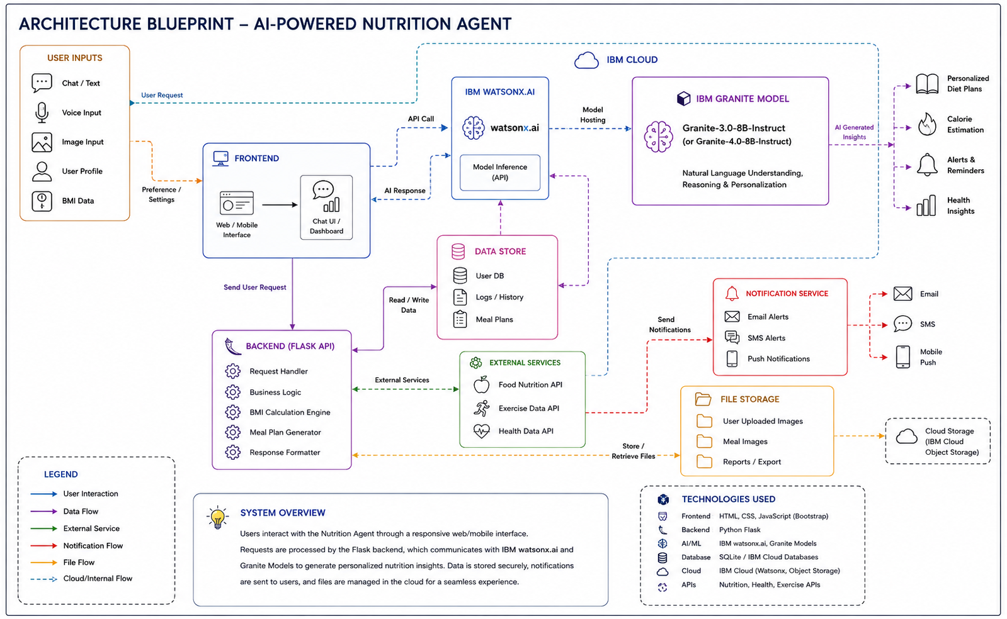
Architecture blueprint -

Slide 7
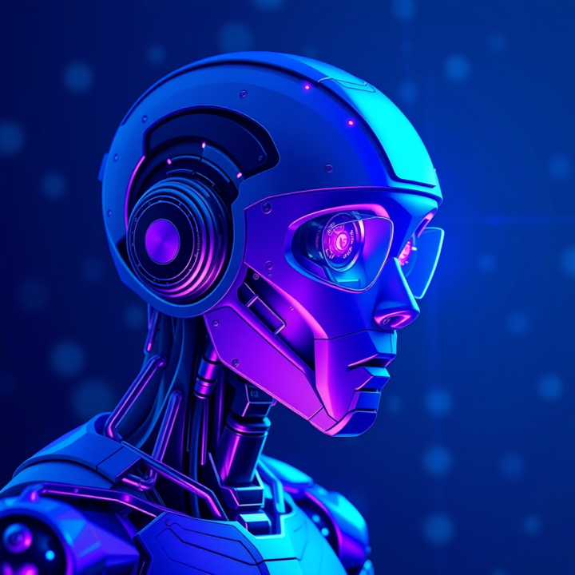
Role of Agentic AI in the solution
Role of Agentic AI in Nutrition Agent
Agentic AI enables the Nutrition Agent to understand user queries and provide intelligent, personalized nutrition guidance. Powered by IBM watsonx.ai and IBM Granite Models, the agent analyzes user inputs such as age, BMI, dietary preferences, and health goals to generate relevant meal recommendations and health insights.
The AI adapts its responses based on user interactions, answers nutrition-related questions, and assists in meal planning, BMI analysis, and food recommendations. By combining reasoning with contextual understanding, the Nutrition Agent delivers accurate, personalized, and interactive support, helping users make healthier dietary decisions and maintain a balanced lifestyle.

Slide 8
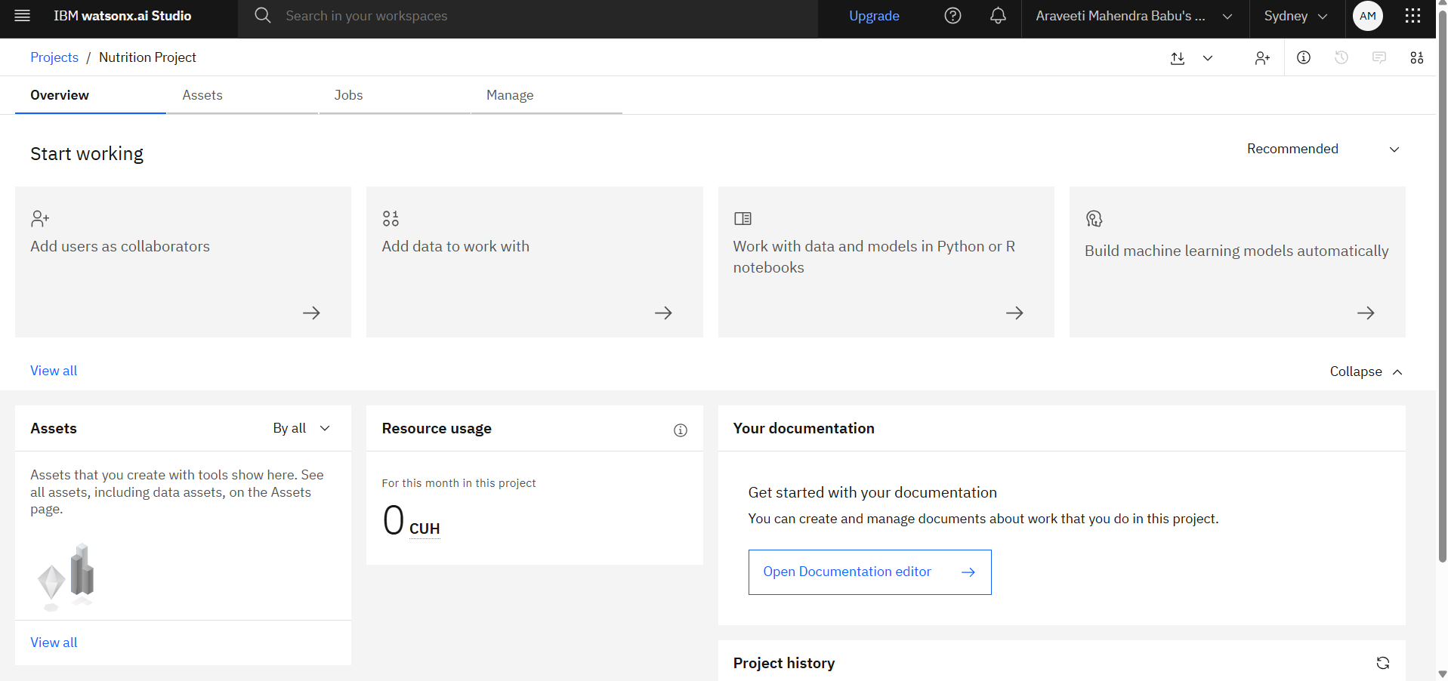
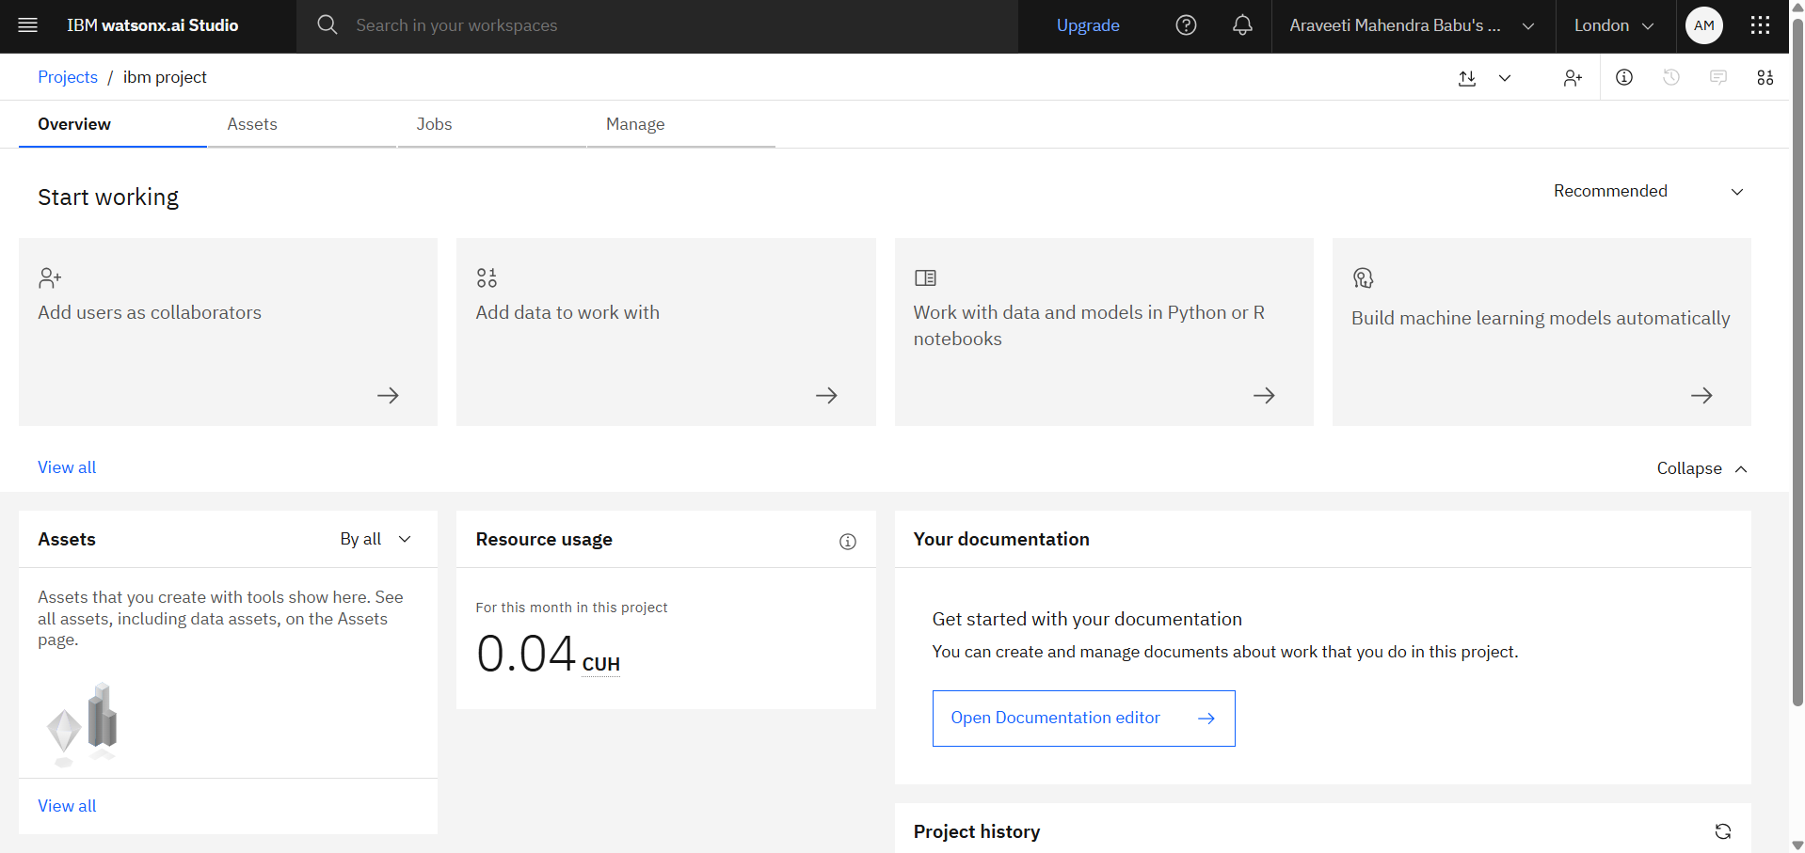
Token Usage
Before Prompt
After the Prompt

Slide 9
Novelty and Uniqueness
The proposed AI-Powered Nutrition Agent combines IBM watsonx.ai Granite Models with a user-friendly web application to deliver personalized nutrition guidance and health insights.
AI-Powered Nutrition Assistant – Provides intelligent and context-aware dietary recommendations using IBM Granite models.
Personalized Meal Planning – Generates customized meal plans based on user preferences, BMI, and health goals.
Interactive Health Dashboard – Visualizes BMI, calorie information, and nutrition insights for better health monitoring.
Family Profile Support – Enables personalized nutrition recommendations for multiple family members.
Real-Time AI Assistance – Instantly answers nutrition-related queries and provides actionable health suggestions.
Cloud-Based Deployment – Built with Python Flask and deployed on Render for easy accessibility.
Overall, the solution acts as an intelligent digital nutrition assistant that helps users make healthier food choices through personalized AI-driven recommendations and an interactive user experience.

Slide 10
Git Hub Link:
https://github.com/Araveetimahendra/Nutrition-Agent-AICTE.git

Slide 11
Future Scope
1. Wearable Device Integration Integrate the Nutrition Agent with smartwatches and fitness trackers to collect real-time health data such as heart rate, daily steps, calories burned, and sleep patterns. This will enable more accurate and personalized nutrition recommendations.
2. Voice Assistant & Multilingual Support Enhance the application with AI-powered voice interaction and support for multiple regional languages, making the Nutrition Agent more accessible, user-friendly, and inclusive for a wider range of users.
3. Image-Based Food Recognition Enable users to upload food images for automatic identification of food items and nutritional analysis using AI-powered image recognition.
4. Advanced Health Monitoring Provide personalized nutrition plans for managing chronic conditions such as diabetes, obesity, and heart disease by incorporating user health history and lifestyle data.

Slide 12
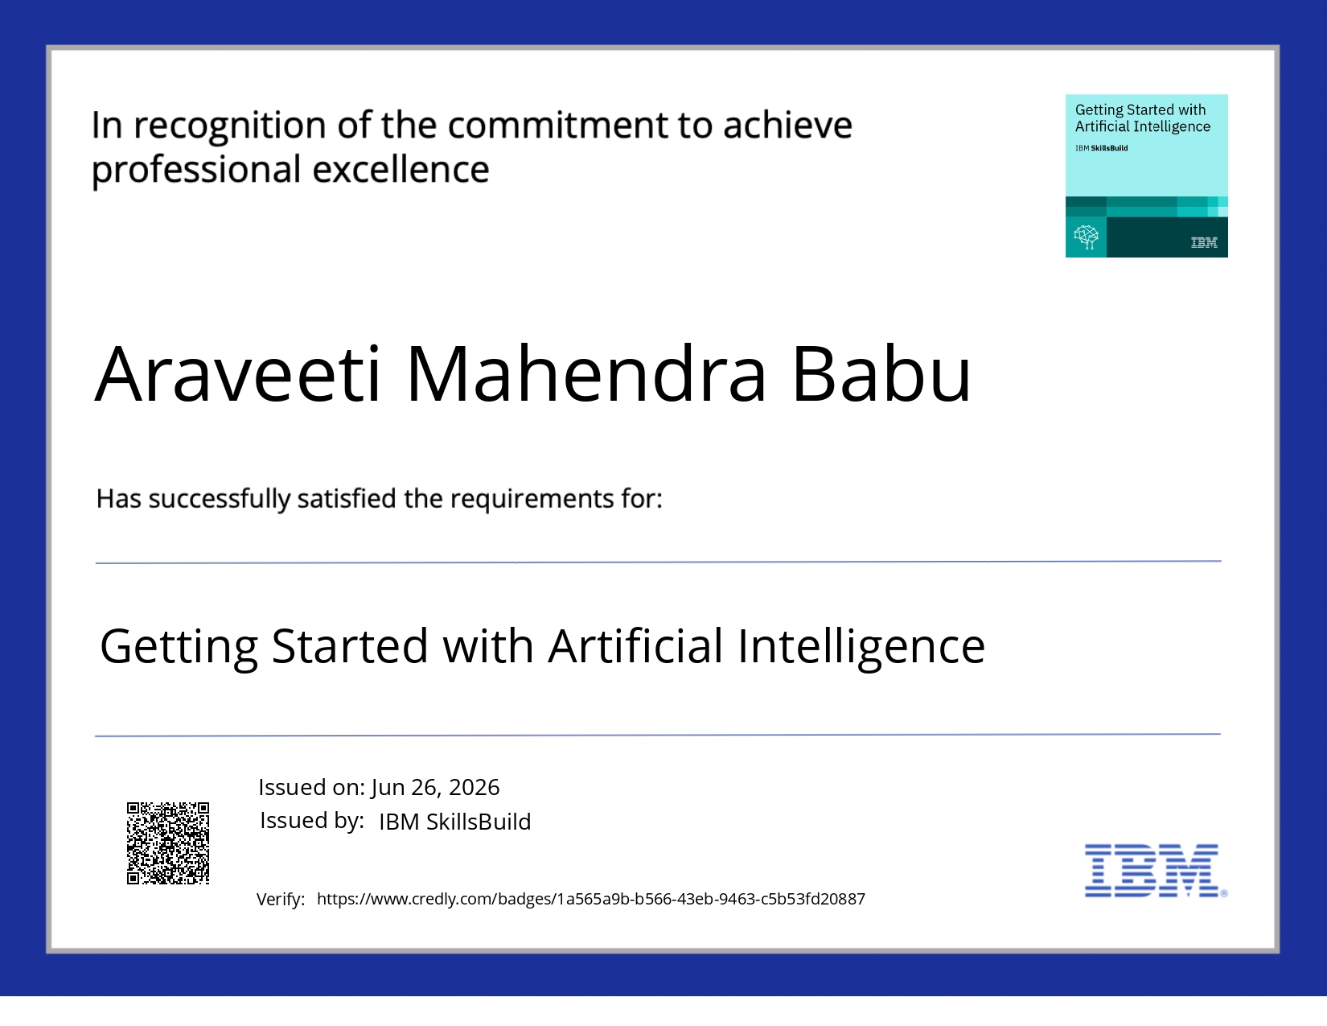
Certificates Earned:

Slide 13
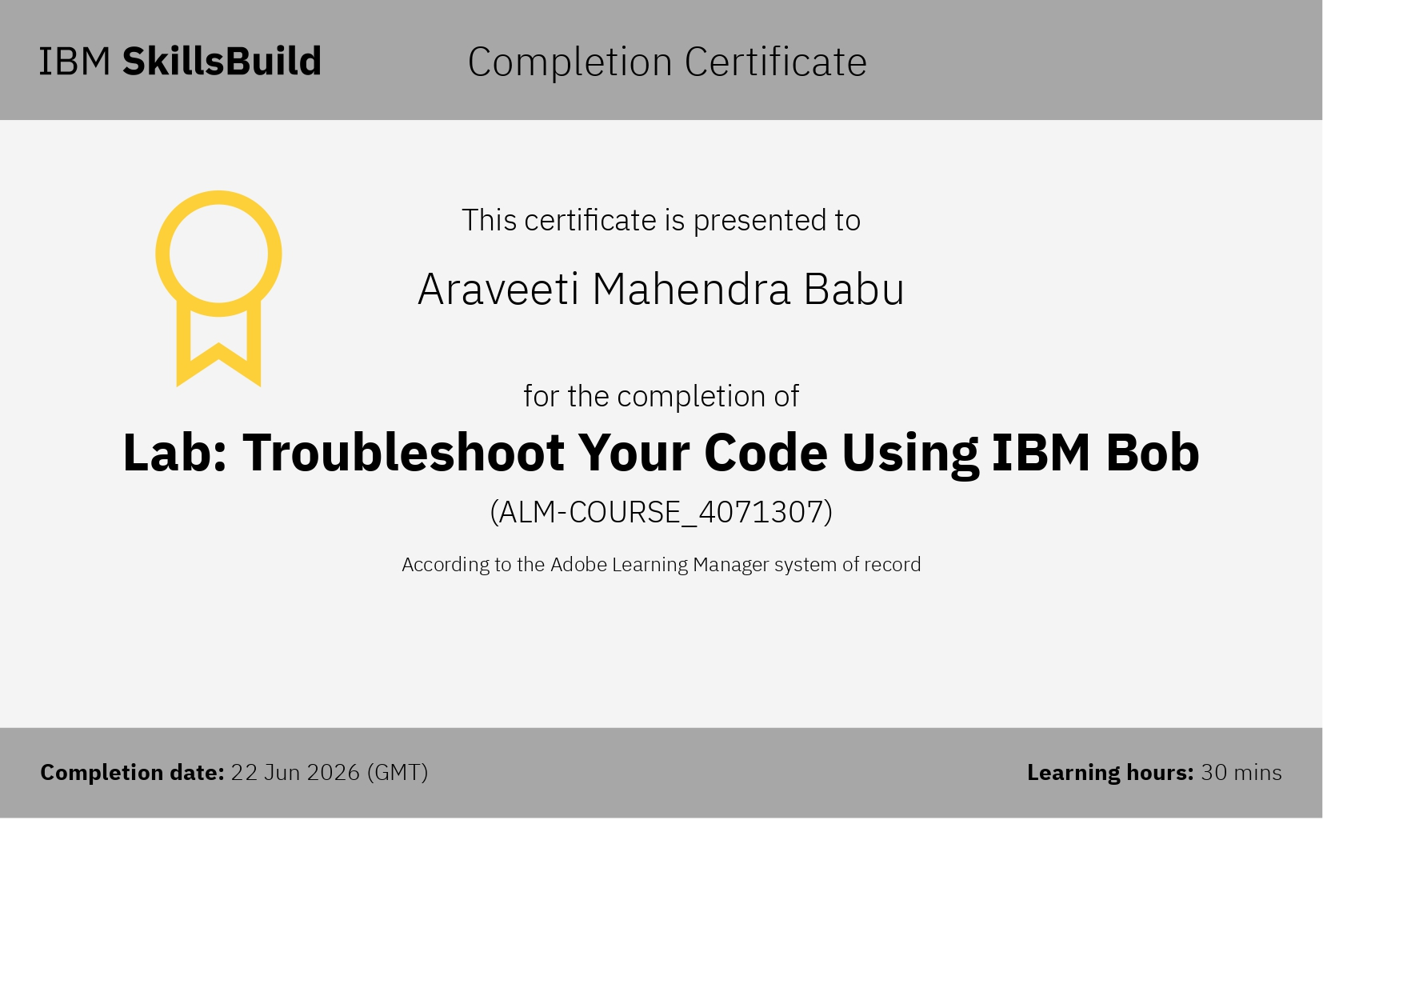
Certificates Earned:​

Slide 14


